Slide 1




Emerging Technology Opportunity Identification Based on Community Detection and Burst Detection:
A Case study of Intelligent Robots
Jingwen Luo ^{1,2}, Zou Fang ³, Yujie Peng⁴, Ying Huang^{1,5*}
1. School of Information Management, Wuhan University, China
2. Information School, The University of Sheffield, United Kingdom
3. School of Public Administration, Hunan University, China
4. Department of Management and Economics, North China University of Water Resources and Electric Power, China
5. Centre for R&D Monitoring (ECOOM) and Department of MSI, KU Leuven, Belgium

Slide 2
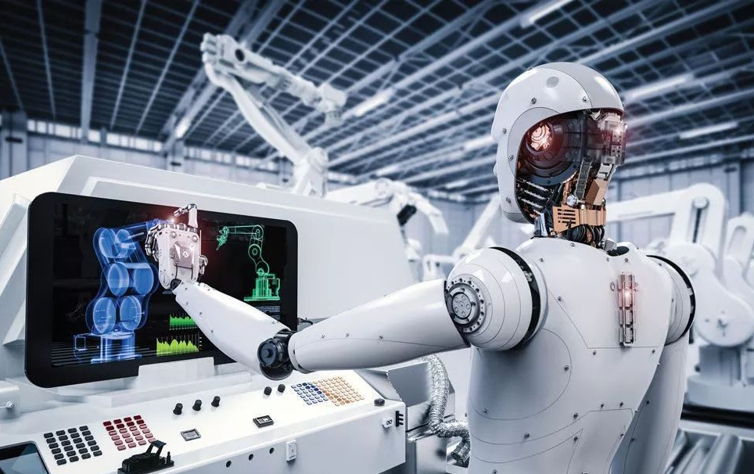

Introduction
How to seek the development opportunity and direction of emerging technologies and win the new technological and industrial revolution has become an important proposition.
Technology Opportunity Analysis (TOA) can monitor the changes of related technology or the socio-economic environment in a specific technology field through technology detection and bibliometrics, and plays a particular role in predicting the technology development in this field.

Slide 3
Literature Review
morphological analysis (Yoon et al., 2008)
Principal Component Analysis, patent maps (Lee et al., 2009)
Co-word analysis (Pan and Xu, 2014)
Text mining and a high-dimensional clustering (Wang et al., 2015)
Subject-Action-Object semantic structure (Wang et al., 2017)
Word2vec (Lee et al., 2020)
One of the research methods of technology forecasting (Yoon and Park, 2005)
New technology forms that emerged from the existing technologies, providing the possibility for the technology innovation to be applied to the production of new technology. (Ma et al., 2014)
Proton exchange membrane fuel cells and direct methanol fuel cells (Ho et al., 2014)
Dye-sensitized solar cells (Ma et al., 2014)
Cloud computing and big data (Chan and Miyazaki, 2015)
5G technology (Zhang and Yu, 2020)
Scholars research and elaborate TOA based on Porter's systematic explanation, focusing on three aspects:
• Connotation and functions
• Methodology and indicators
• Empirical studies
The proposed framework of Technology Opportunity Analysis (TOA) clarify the overall context of emerging technologies' and assist strategic planning from multiple dimensions (R&D trend, Competitive Environment, Technology Layout) to examine the technology opportunities of emerging technologies.

Slide 4
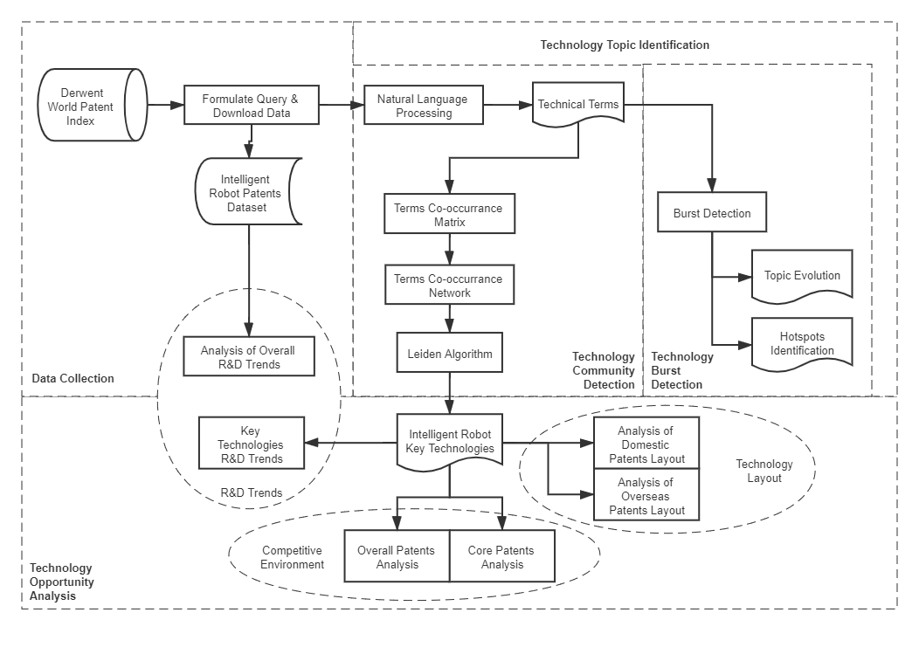
Framework
Data Collection
Derwent World Patent Index (DWPI)
(ABD=(((Autonomous OR Bio* OR Humanoid OR Smart OR Intelligent) ADJ2 Robot*) OR Bio-robot* OR Biorobot* OR (Robot* Cognit*) OR (Robot* Percept*) OR (Robot* Sens*) OR (Robot* Act*)) AND PY=(1956 - 2018))
10,433 patents were retrieved
(conducted on 20 February 2020)
Technology Topic Identification
Use Natural Language Processing to extract technical terms from patent titles
Build co-occurrence matrix and network from technical terms
Use Leiden Algorithm to detect communities (namely key technologies)
Use Burst Detection Algorithm to trace topic evolution and hotspots
Technology Opportunity Analysis
Analyze the overall and specific R&D trends of key technologies of Intelligent Robot
Analyze the competitive environment of key technologies of Intelligent Robot from overall scale and core patents
Analyze the domestic and overseas patents layout of key technologies of Intelligent Robot

Slide 5
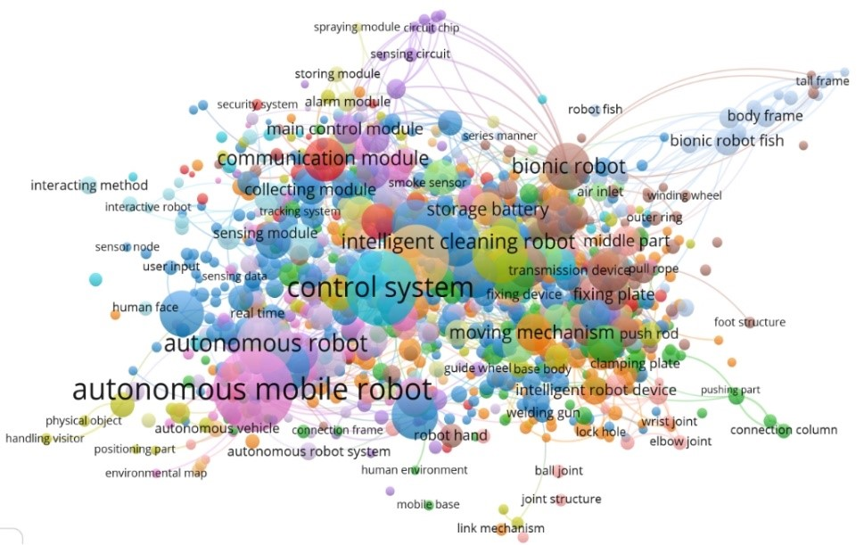
Humanoid Robot
Robot Joint
Mechanical Arm
Driving Mechanism
Sensor
Wireless Communication
Servo Motor
System Controller
Remote Control
Path Planning
Robot Voice
Robot Vision
Detection Mechanism
Robot Interaction
Robotic Fish
Intelligent Robots for Different Usage
Findings-Key Technologies
Fig. 1. Clustering Visualization of Intelligent Robot Key Technologies

Slide 6
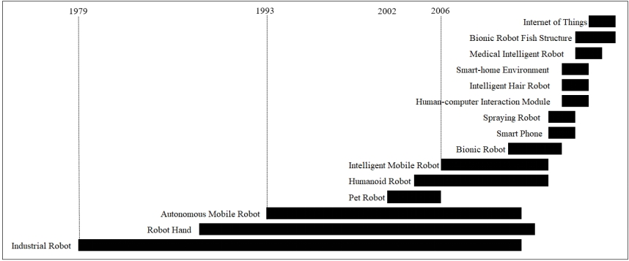
Findings-Topics Evolution
Fig. 2. The Evolution of Intelligent Robot Technologies Topics
We broadly divide the evolution of intelligent robots technology topics into three time zones: 1979-1993, 1994-2006, and 2006-2018.

Slide 7
Findings-Burst Hotspots
Table 1. Burst Hotspots of Intelligent Robots in recent years
Burst Hotspots | Weight | Duration | Start
Internet-of Thing robot | 5.982 | 2 | 2017
Bionic Robot Fish Structure | 5.431 | 3 | 2016
Charging Pile | 5.156 | 1 | 2018
Multi-Modal Output | 4.858 | 3 | 2016
Resistance Layer | 4.448 | 2 | 2017
Intelligent Robot Human-Computer Interaction | 4.399 | 2 | 2017
Intelligent Security Robot | 4.342 | 2 | 2017
Unmanned Aerial Vehicle | 4.164 | 1 | 2018
Pneumatic Muscle | 3.746 | 1 | 2018
Grabbing Robot | 3.673 | 1 | 2018
The burst weights were calculated and ranked in descending order, and we considered the highest ranked topics that had not yet reached a steady-state as being related to burst hotspots of intelligent robots.

Slide 8
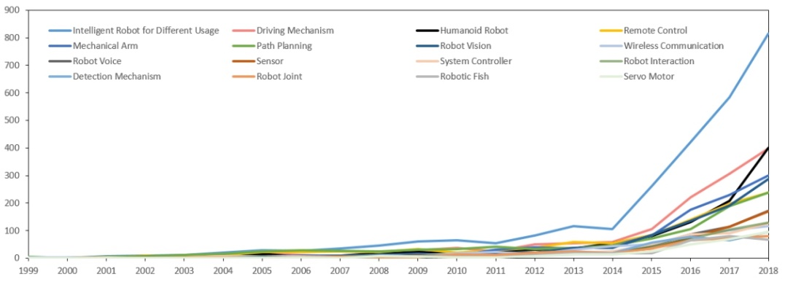
Findings-R&D Trend
Fig. 3. Analysis of the R&D Trend of Key Technologies of Intelligent Robot
The majority of key technologies have accelerated in growth since 2014.
Intelligent Robot for Different Usage has always been the focus of technology development.
System Controller and Robot Joint may step into the ranks of rapid development in the future.

Slide 9
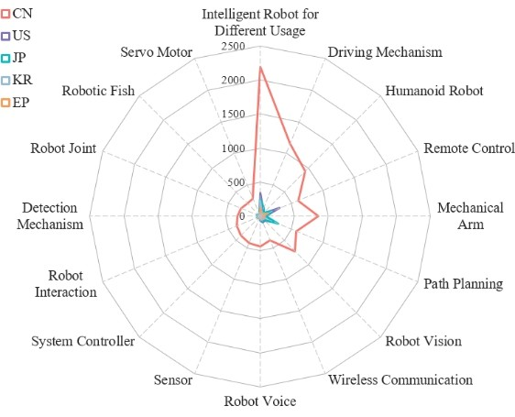
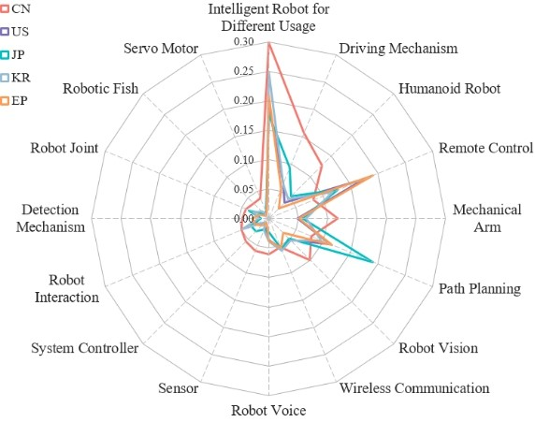
Findings- Competitive Environment
Europe has the most considerable presence in Remote Control;
Japan featured prominently in Path Planning;
South Korea has the largest share of Wireless Communication;
the US distinguished itself on Remote Control, Path Planning, and Driving Mechanism.
China has an absolute advantage in the scale of intelligent robot patents.
The layout of key technologies of the 5 countries/regions is, to a certain extent, similar.
(a) Patent Counts
(b) Patent Proportion
Fig. 4. Distribution of 16 Key Technologies in Major Countries/Regions

Slide 10
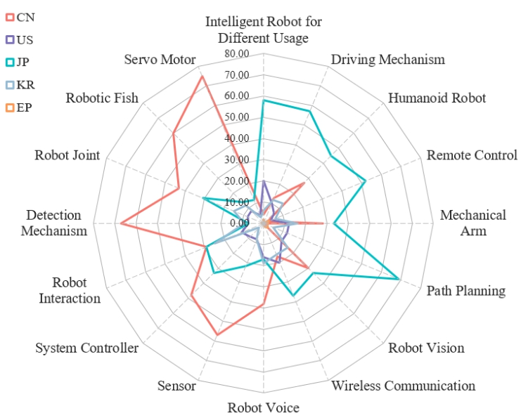
Findings- Competitive Environment
Core patents are those with a key position in a particular field, which make an outstanding contribution to technological development and have a high economic value.
Indicators to measure core patents: the number of citations, the number of patent families, and the number of claims.
Fig. 5. Core Patents Comparison of the 5 Countries/Regions

Slide 11
Findings-Technology Layout
China’s Domestic Technology Market:
93.93% (6896/7342 = 0.9393)
Table 2. Patent Priority and Patent Family of Intelligent Robot Technologies in Main Countries/Regions
 | China (7342) | US (1790) | Japan (1475) | Korea (890) | Europe (617)
China (6905) | 6896 | 51 | 29 | 11 | 22
U.S. (1091) | 168 | 1056 | 188 | 59 | 230
Japan (1111) | 102 | 250 | 1086 | 47 | 86
Korea (737) | 51 | 240 | 46 | 725 | 63
Europe (73) | 21 | 49 | 41 | 17 | 72
Family
Priority
Patent priority country/regions can indicate the place of origin of the technology, while the countries/regions distribution of patent families can describe the technology's market layout.
China is the most prominent source of technology and the largest technology market. China's domestic technology market is relatively saturated and needs to seek breakthroughs from overseas markets.

Slide 12
Limitations
Secondly, the framework designed for the opportunity analysis of the clustering results was based solely on the patents' perspective.
In analyzing the competitive environment, we only assessed the competition between countries at a macro level
Firstly, when extracting terms from patent titles, the overly long terms were not accurately segmented, thus some of the terms are not counted in the co-word analysis, which may affect the results of the topic clustering identification.

Slide 13
Reference
[1] Yoon, B., & Park, Y. (2005). A systematic approach for identifying technology opportunities: Keyword-based morphology analysis. Technological Forecasting and Social Change. https://doi.org/10.1016/j.techfore.2004.08.011
[2] Chan, S. K., & Miyazaki, K. (2015). Knowledge convergence between cloud computing and big data and analysis of emerging technological opportunities in Malaysia. Portland International Conference on Management of Engineering and Technology. https://doi.org/10.1109/PICMET.2015.7273134
[3] Ho, J. C., Saw, E. C., Lu, L. Y. Y., & Liu, J. S. (2014). Technological barriers and research trends in fuel cell technologies: A citation network analysis. Technological Forecasting and Social Change. https://doi.org/10.1016/j.techfore.2013.06.004
[4] Lee, C., Jeon, D., Ahn, J. M., & Kwon, O. (2020). Navigating a product landscape for technology opportunity analysis: A word2vec approach using an integrated patent-product database. Technovation. https://doi.org/10.1016/j.technovation.2020.102140
[5] Lee, S., Yoon, B., & Park, Y. (2009). An approach to discovering new technology opportunities: Keyword-based patent map approach. Technovation. https://doi.org/10.1016/j.technovation.2008.10.006
[6] Ma, T., Porter, A. L., Guo, Y., Ready, J., Xu, C., & Gao, L. (2014). A technology opportunities analysis model: applied to dye-sensitised solar cells for China. Technology Analysis and Strategic Management. https://doi.org/10.1080/09537325.2013.850155
[7] Pan, D., & Xu, K. (2014). Technology opportunity analysis based on co- word analysis. Science Research Management, 04, 10–17. https://doi.org/10.19571/j.cnki.1000-2995.2014.04.002
[8] Porter, A. (1994). Technology Opportunities Analysis: Integrating Technology Monitoring, Forecasting, and Assessment with Strategic Planning. SRA Journal.
[9] Wang, M. Y., Fang, S. C., & Chang, Y. H. (2015). Exploring technological opportunities by mining the gaps between science and technology: Microalgal biofuels. Technological Forecasting and Social Change. https://doi.org/10.1016/j.techfore.2014.07.008
[10] Wang, X., Ma, P., Huang, Y., Guo, J., Zhu, D., Porter, A. L., & Wang, Z. (2017). Combining SAO semantic analysis and morphology analysis to identify technology opportunities. Scientometrics. https://doi.org/10.1007/s11192-017-2260-y
[11] Xu, H., Yue, Z., Lei, B., & Fang, S. (2014). Core Patents Mining based on Cross Co-occurrence Analysis to Patent Technology-Effect Subject Terms and Citations. Library and Information Service, 04, 59–64. https://doi.org/10.13266/j.issn.0252-3116.2014.04.010
[12] Yoon, B., Phaal, R., & Probert, D. (2008). Morphology analysis for technology roadmapping: Application of text mining. R and D Management. https://doi.org/10.1111/j.1467-9310.2007.00493.x
[13] Zhang, J., & Yu, W. (2020). Early detection of technology opportunity based on analogy design and phrase semantic representation. Scientometrics. https://doi.org/10.1007/s11192-020-03641-z

Slide 14
Thank you for your attentions
Q&A

